Slide 1
Corona travel
Sofya Donskaya
Elena Karelina
Danil Kireev
Artem Filimonov

Slide 2
Project statement
Our goal in to allow users to travel online from home via any device of their liking. They'll start by opening an app or a link and choosing a desired destination. After choosing a location, users can choose to view destination in 3D, look at some 3D photos or videos or learn some facts about the place. To achieve this we plan on creating a scalable infrastructure of client-server using modern technologies. Client, or frontend, will be written using React and Typescript while server, or backend, will be written using python and fastapi framework for it's integrated documentation.
Team: Sofya Donskaya, Elena Karelina, Danil Kireev, Artem Filimonov
Project repo: https://github.com/randomunrandom/corona_travel
This report: https://docs.google.com/presentation/d/1mBnqTmKWgPbGQHDyXbN9vKNHnVUsRbbwefRanOrMvP0/edit?usp=sharing

Slide 3
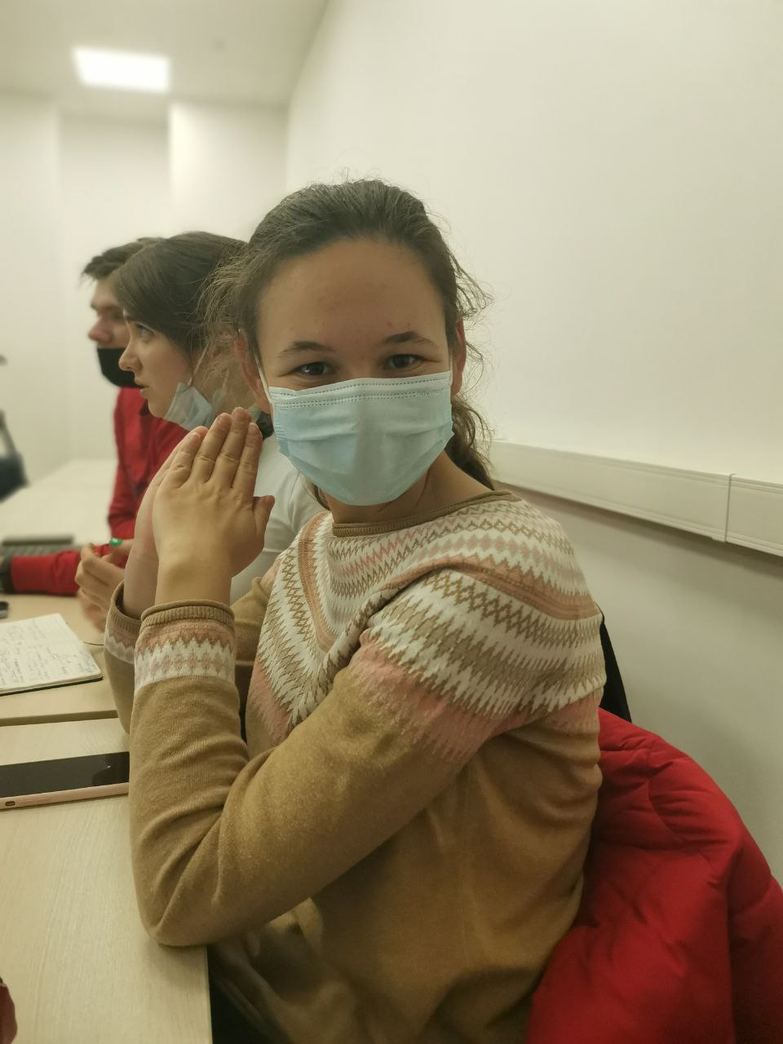

Personas
Name: Lena
21 y. o.
Software engineer student
work as C++ developer
Lena wants to go to Spain but the country is closed
Name: Sergey
has 5 kids
does not have money to travel with family

Slide 4
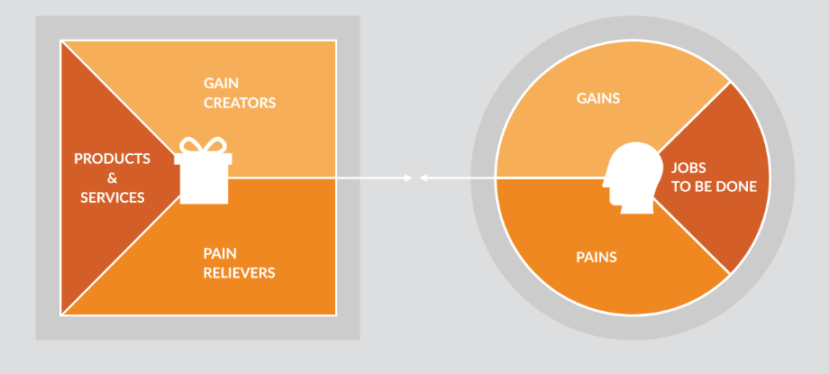
Value proposition canvas (optional - for each persona)
https://drawio-app.com/create-a-value-proposition-canvas-with-draw-io/#

Slide 5
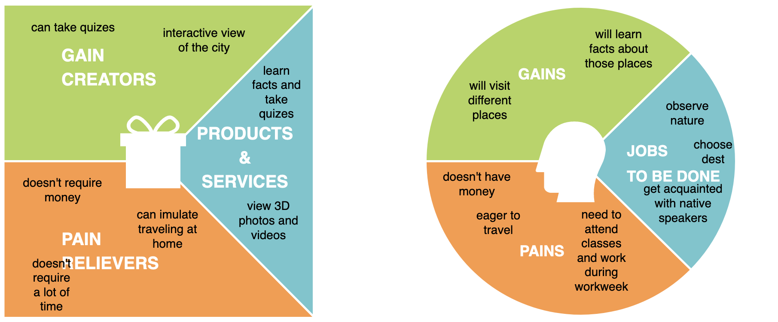
Value proposition canvas for Lena

Slide 6
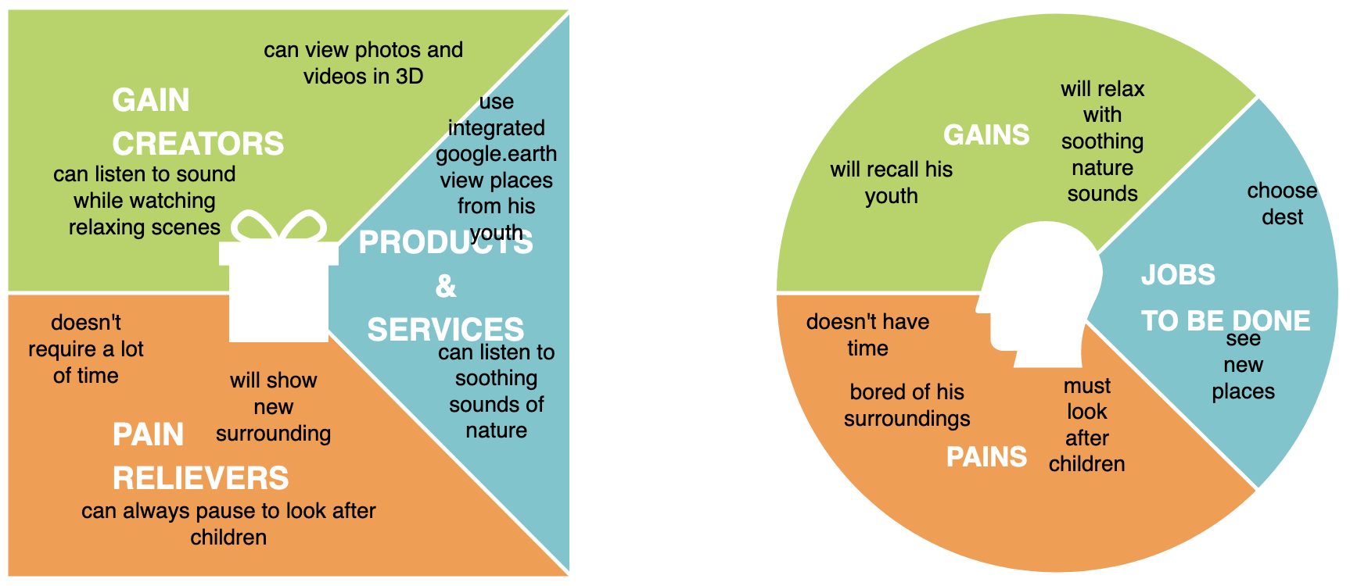
Value proposition canvas for Sergey

Slide 7
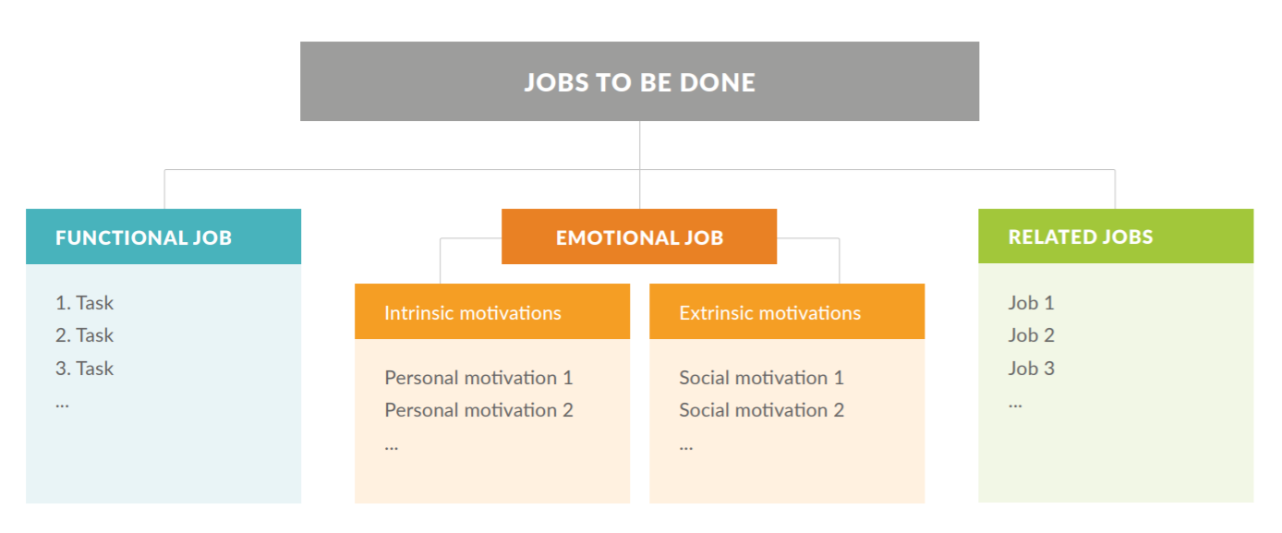
Jobs map (optional - for each persona)
https://drawio-app.com/wp-content/uploads/2018/10/drawio-jobs-to-be-done-white-paper.pdf

Slide 8
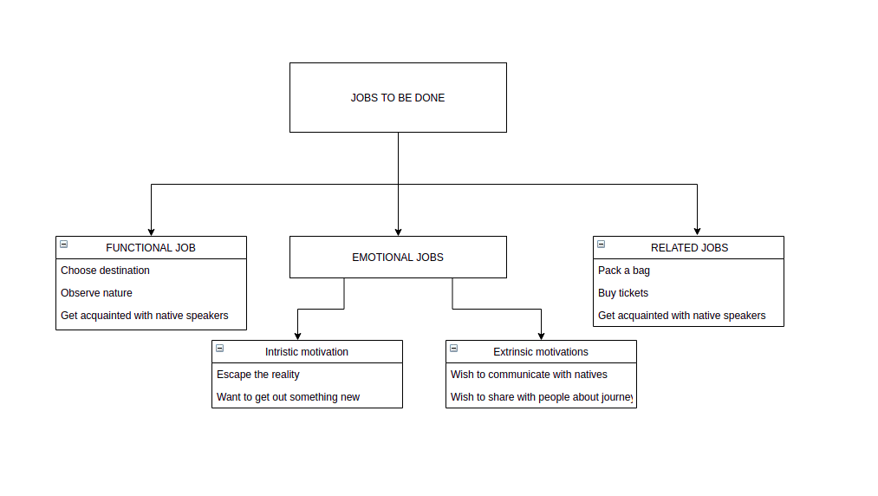
Jobs map for Lena

Slide 9
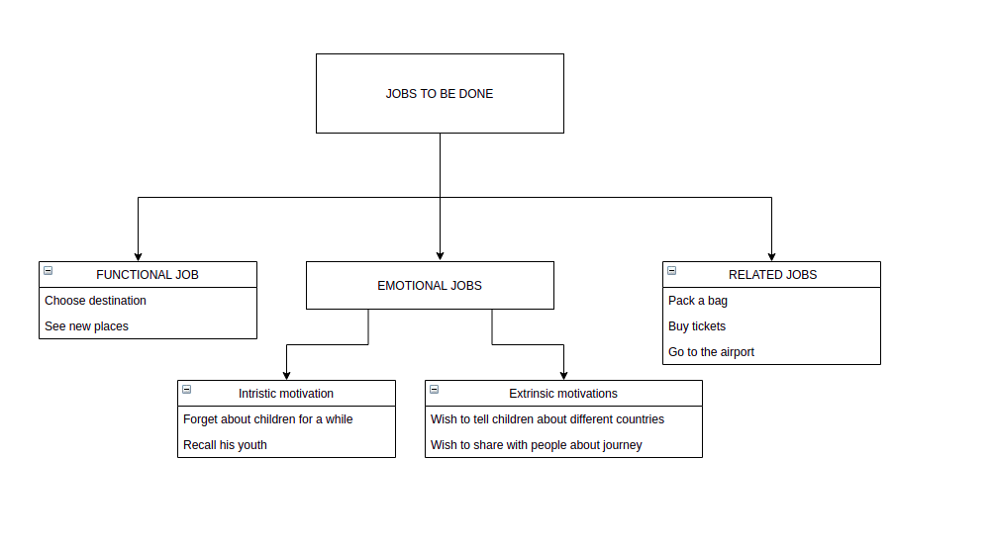
Jobs map for Sergey

Slide 10
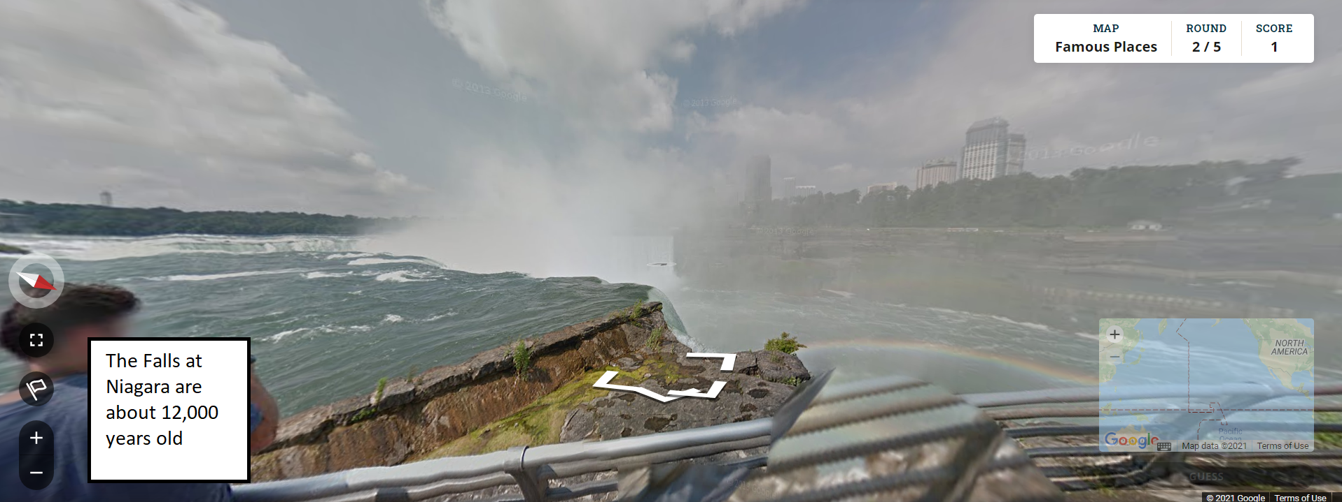
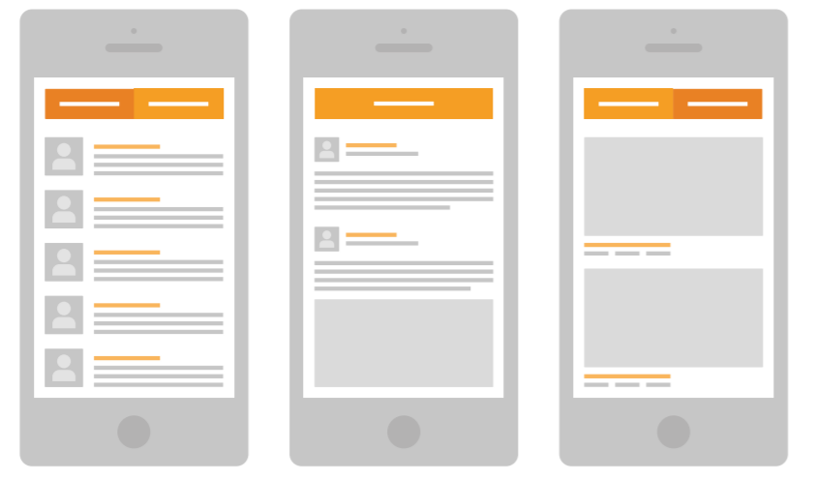
Prototype User Interfaces (wireframes)

Slide 11
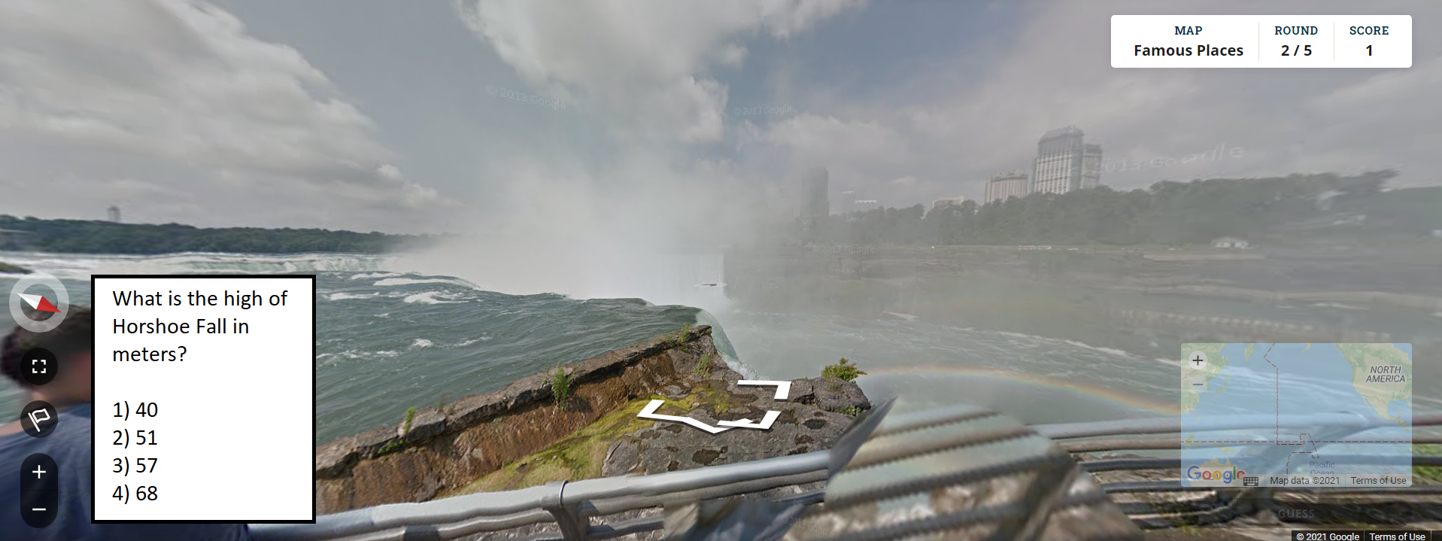
Prototype User Interfaces (wireframes)

Slide 12
Story map
As a <Sergey>
I want to <travel abroad, observe nature and visit new places>
So that <I will gain a new experience and will not spend much time and money>
I want to <choose the destination and go to explore new sights>
So that <I will be surrounded by nice landscapes>
I want to <listen to nice sounds and enjoy waterfalls>
So that <I can relax after work>
As a result I have relaxed and start loving my children again :Ↄ
As a <Lena>
I want to <relax after my work and studying>
So that <I will be recharged for the next day>
I want to <move to another country and get known with historical facts and have a fun time by solving quiz>
So that <I will gain knowledge and experience>
As a result I have done it and enjoyed my life :)

